Slide 1
Modern data assignment
Submitted by:- Lokendra yadav
School of data science and forecasting(DAVV)

Slide 2
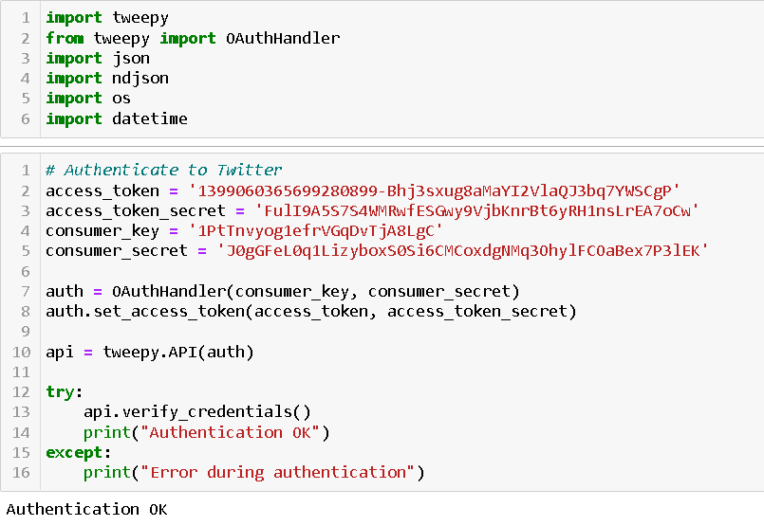
Stage-1 Find recent tweets using the keyword and store the raw data in log files.
For extracting tweets first we have to install tweepy library, by which we are going to authenticate our system with twitter’s api.
Tweepy supports both OAuth 1a (application-user) and OAuth 2 (application-only) authentication. Authentication is handled by the tweepy.AuthHandler class.
OAuth 2 is a method of authentication where an application makes API requests without the user context. Use this method if you just need read-only access to public information.
You first register our client application and acquire a consumer key and secret. Then you create an AppAuthHandler instance, passing in our consumer key and secret.

Slide 3
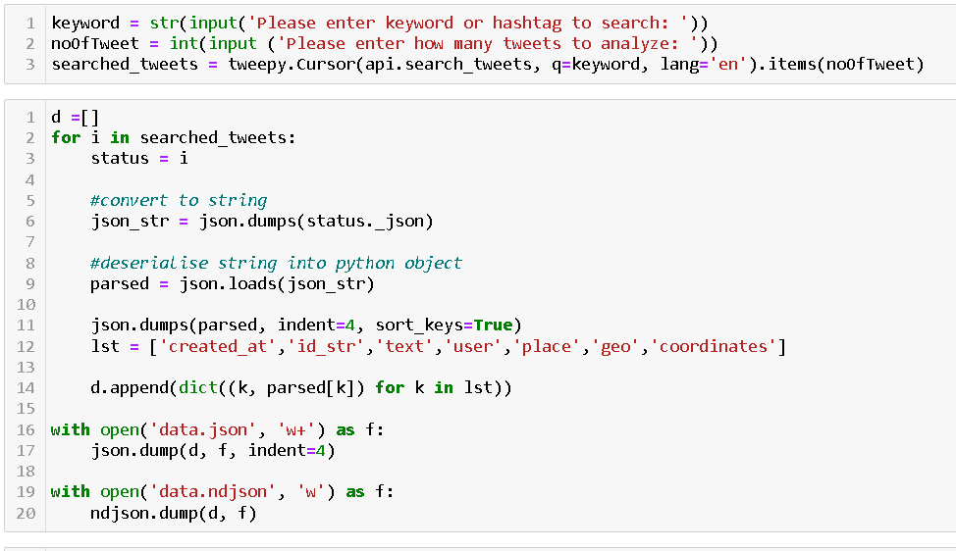
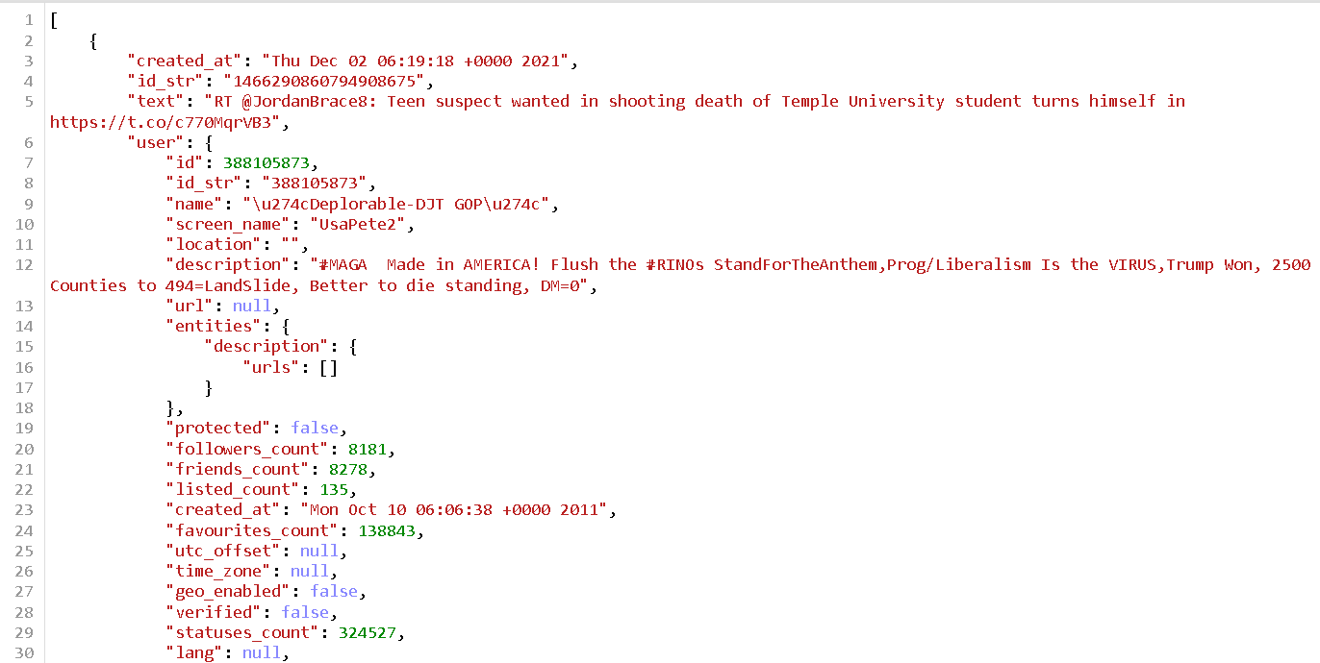
write a program that takes keyword as input and finds recent tweets containing that keyword using twitter’s official API and store the raw data (tweet JSON object) in files .
After getting tweets we are storing them in a json format(data.json) ad mentioned in problem statement.

Slide 4
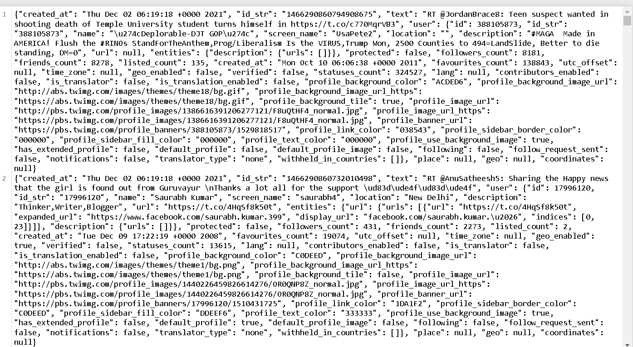
we're going to write tweet JSON object per LINE in the log file. Each line can then be parsed individually.

Slide 5
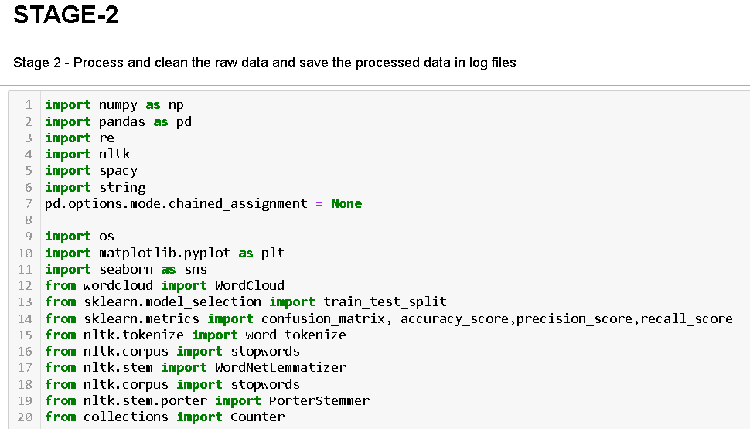
Stage-2 Process and clean the raw data and save the processed data in log files
For cleaning and preprocessing the data we are importing necessary libraries.

Slide 6
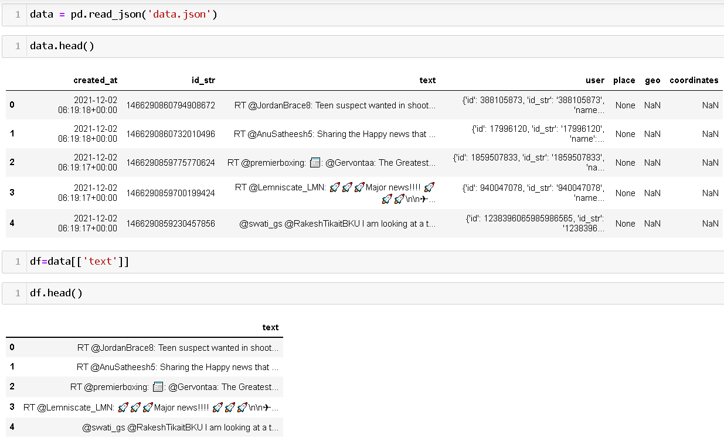
In stage 1 we had store a data in json format(data.json).
Here we are reading a json file In pandas dataframe because we have to perform preprocessing on data and preprocessing is directly not possible on the json format.
After that we are extracting ‘text’ column on which we are goint to perform our all task.

Slide 7
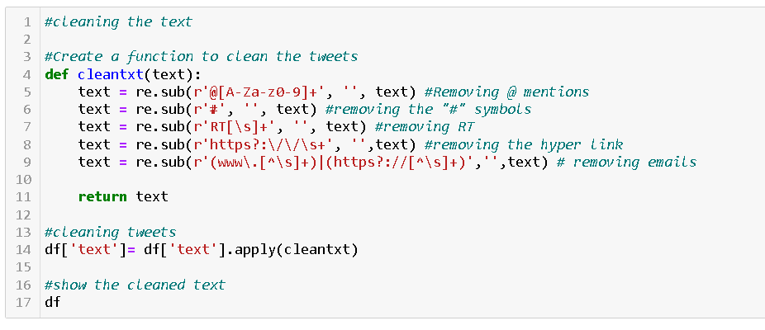
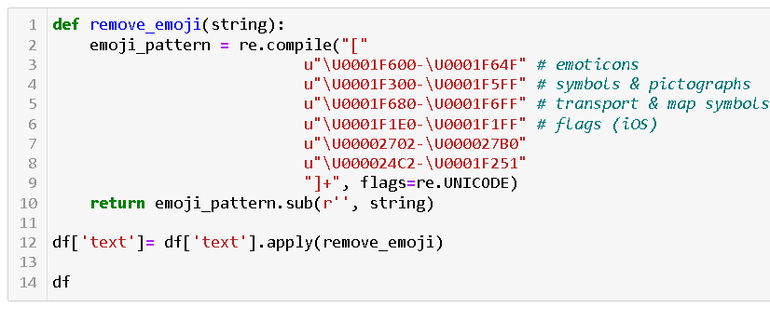
In the above code we remove all the puntuations, emails, rt, hyperlinks. extra whitespace and convert the whole text into lowercase. And in second code we are removing emojis, symbols

Slide 8
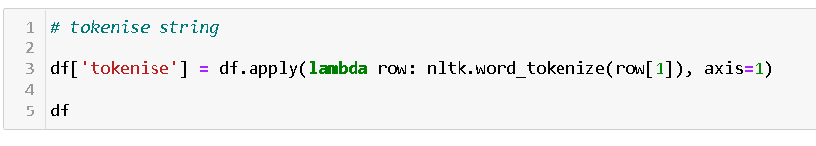
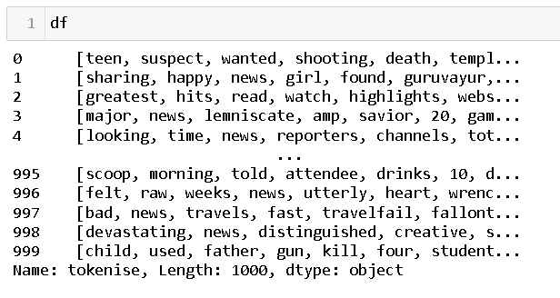
In this code we will tokenize the reviews text.Tokenization is the important step in text analytics. The process of breaking down a text paragraph into smaller chunks such as words or sentence is called Tokenization.
As mentioned in problem statement

Slide 9
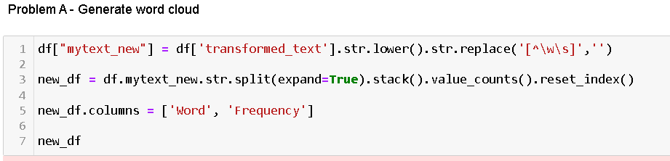
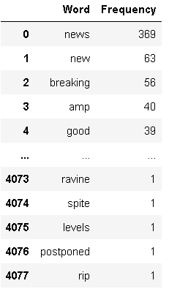
Stage-3 problem(a)
Here we are using our preprocessed stage 2 data
In this code we are extracting how many word are present in our tweets in descending manner.

Slide 10
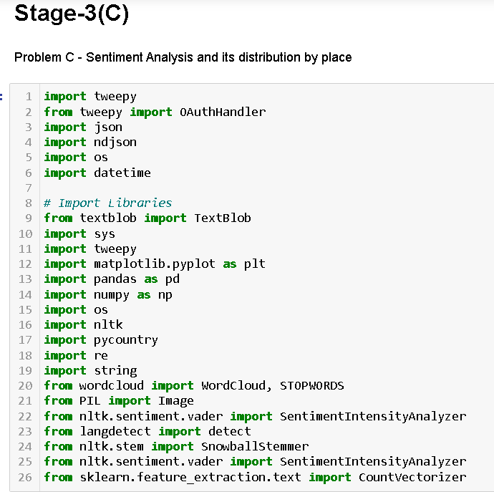
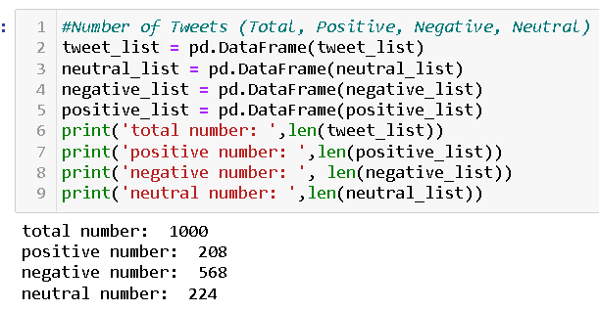
The user should type keyword or hashtag (article-370) and type how many tweets (1000) that want to get and analyse.
The number of tweets parameter is important because of the limit.

Slide 11
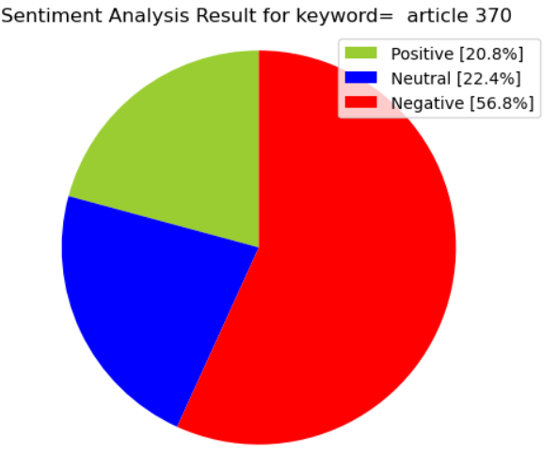
208 (20.8%) of tweets include positive sentiment
568 (22.4%) of tweets include negative sentiment
224 (56.8%) of tweets include neutral sentiment

Slide 12
Thank you

